Slide 1

Please delete this sheet before submitting

Slide 2


Using The WORK BREAKDOWN STRUCTURE Sheet
Should you face any difficulty in completing this phase, please refer to 'Project Planning' Workshop, https://cloudcounselage.graphy.com/sessions/Project-Planning-64af88dcb308530823e2c19f
Before submitting the file, please rename the file as ‘IAC IP23 – WBS – Your Domain Name – Your full name’ and submit as PDF
The Work Breakdown Structure (WBS) provided is just a guideline, you are allowed to modify the same based on your problem statement
Given the timeline and deliverables the WBS is based on Waterfall Methodology
Add tasks wherever required based on your problem statement
Follow the below colours for Project hierarchy
Please delete this sheet before submitting
Project Goal
Phases
Stages
Activities/
Deliverables
Tasks

Slide 3
WORK BREAKDOWN STRUCTURE – IP26 Live Project Deliverables– ‘Machine Learning’
Career Path Prediction System
INITIATION
Project Charter
SRS Document
PLANNING
WBS
Project Schedule
RAID Logs
EXECUTION & MONITORING
Design
Requirement Questionnaire
Data Cleaning
Feature Encoding
Train/Test Split
Develop
Decision Tree Model
Random Forest Model
XGBoost Model
Hyperparameter Tuning
Streamlit UI
Test
Model Evaluation
App Testing & Bug Fixing
Deploy
Streamlit Cloud Deployment
CLOSURE
Lessons Learnt Log
Project Report
README Documentation
Final Presentation

Slide 4

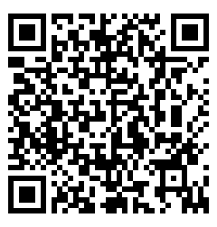
Our Contact
Please delete this sheet before submitting
Member@IndustryAcademiaCommunity.com
You may even raise queries in the Q&A section of your respective domain community on the IAC platform

